Slide 2
Economic Regulation and Digital Transformation
By Helene Vosloo
Head: Economics and Sector Research
10 October 2016

Slide 3
INTRODUCTION
The ICT industry is playing an increasingly important role in the global economy.
Because of its size and the nature of its products, the industry has a notable role to play in encouraging economic growth and contributing to other social goods, including improving education and healthcare access and services.

Slide 4
INTRODUCTION
How does CRAN ensure that ICT continues to contribute to the economy?
Provision of data
Termination Rates
Dominance and Competition in the industry
Reduction of Roaming Rates in the region

Slide 5
DATA COLLECTION
CRAN embarked on data collection in 2012

Slide 6
DATA COLLECTION
A number of international and national organisations use the data collected by CRAN to measure Namibia’s economic and social performance.

Slide 7
DATA COLLECTION

Slide 8
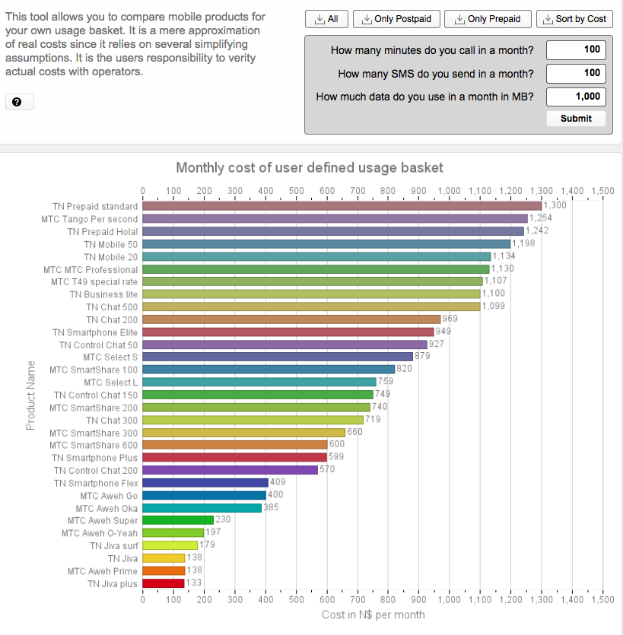
DATA COLLECTION

Slide 9
DATA COLLECTION
CRAN also uses the data to publish:
Quarterly Statistics Newsletter
Annual Market Report
CRAN portal

Slide 10
TERMINATION RATES
Call termination is a natural monopoly
Cost-based termination rates encourage competition and affordable pricing.
Cost-based termination rates remove market distortions and provide efficient investment incentives.
The net effect of fair competition is lower costs of communication, better services and more equitable returns on investment for all operators.

Slide 11
TERMINATION RATES
As from 4 Oct 2016 the termination rate dropped to 10c.

Slide 12
DOMINANCE
Competition is needed to:
attract investment
induce more efficient suppliers
greater choice of products and services
lead to lower prices
In terms of Section 78 of the Communications Act CRAN needs to determine dominant players in the telecommunications industry every 3 years.

Slide 13
DOMINANCE
Dominant Players are:

Slide 14
ROAMING IN THE SADC REGION
The overall project goal is to facilitate the lowering of the roaming prices and allow for the increase in communication across the SADC borders thereby facilitating the social and economic development of the Region.
Six countries are currently implementing, namely Botswana, Mozambique, Namibia, Swaziland, Zambia and Zimbabwe.
On average retail voice tariffs for “calls to home countries” reduced by 19%.
Retail data tariffs reduced on average by more than 60%.

Slide 15
ROAMING IN THE SADC REGION

Slide 16
CONCLUSION
Initiatives to grow the ICT industry through competition at all levels benefit:
The consumer
The industry
The economy at large.
CRAN takes this mandate very serious and since digital transformation indeed leads to economic growth and prosperity.

Slide 17
Thank you !

